Slide 1




Data Storage: MySQL, HBase, Cassandra and MongoDB
Julien Heck
Hadoop and Managing Big Data
UCLA Extension

Slide 2
Introduction to Databases
A database is a collection of data stored in some organized fashion.
The database software is the called the Database Management System (DBMS)
For relational databases, it is called RDBMS.
The database is the container created and manipulated via the DBMS.

Slide 3
Tables
Within a database, a table is a structured list of data of a specific type.
Usually with relational databases, the data stored in a table is one type of data or one list (e.g. one table for Customers, one table for Orders, etc.).
Every table in a database has a name that identifies it. That name is always unique, meaning no other table in that database can have the same name.
Table have characteristics and properties that define how and what kind of data is stored in them.
This set of information that describes a table is known as a schema.
Schema are used to describe specific tables within a database.

Slide 4
Columns and Datatypes
Tables are made up of columns. A column contains a particular piece of information within a table.
A column is a single field in a table. All tables are made up of one or more columns.
Each column in a database has an associated datatype. A datatype defines what type of data the column can contain (e.g. Integer, Character Array, etc.).
Datatypes restrict the type of data that can be stored in a column (e.g. preventing the entry of alphabetical characters into a numeric field).
Datatypes help sort data correctly and play an important role in optimizing the disk usage.

Slide 5
Rows and Primary Keys
Data in a table is stored in rows; each record saved is stored in its own row.
A row is basically a record.
Every row in a table should have some column (or set of columns) that uniquely identifies it (but this is not mandatory).
This column (or set of columns) that uniquely identifies each row in a table is called a Primary Key.
The primary key meets the following conditions:
No two rows can have the same unique primary key value.
Every row must have a primary key value (NULL are not allowed).
Values in the primary key columns should never be modified or updated.

Slide 6
Introduction to SQL
SQL is an abbreviation for Structured Query Language.
SQL is a language designed specifically for communicating with databases.
SQL is designed to provide the programmer with a simple and efficient way to read and write data from a database.
SQL has several advantages:
SQL is not a proprietary language used by specific database vendors. Almost every DBMS supports SQL.
SQL is easy to learn. The statements are all made up of descriptive English words and there aren’t many of them.
Despite its apparent simplicity, SQL is actually a very powerful language, allowing to perform very complex and sophisticated database operations.

Slide 7

SQL - SELECT
Use SELECT to retrieve table data
You must, as a minimum, specify two pieces of information
What you want to select
From where you want to select it

Slide 8
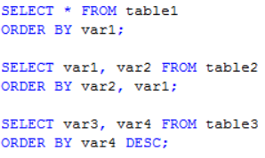
SQL – ORDER BY
With SELECT statements, data will typically be displayed in the order in which it appears in the underlying tables.
To explicitly sort data retrieved using a SELECT statement, the ORDER BY clause is used.
ORDER BY takes the name of one or more columns by which to sort the output.

Slide 9
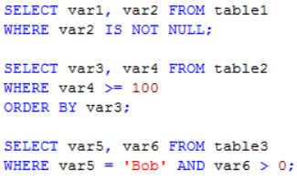
SQL - WHERE
Retrieving just the data you want involves specifying search criteria, also known as a filter condition.
Within a SELECT statement, data is filtered by specifying search criteria in the WHERE clause.
The WHERE clause is specified right after the table name (FROM clause).

Slide 10
SQL – Aggregate functions
Aggregate functions operate on a set of rows to calculate and return a single value.
Function | Description
AVG() | Returns a column's average
COUNT() | Returns the number of rows in a column
MAX() | Returns a column's highest value
MIN() | Returns a column's lowest value
SUM() | Returns the sum of a column's values

Slide 11
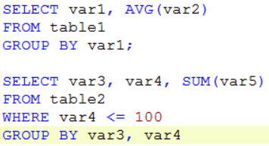
SQL – GROUP BY
Groups are created using the GROUP BY clause in your SELECT statement.
Grouping lets you divide data into logical sets so that you can perform aggregate calculations on each group.

Slide 12
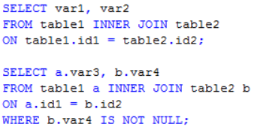
SQL – INNER JOIN
Joins are one of the most important and most powerful operations that you can perform using SELECT.
Joins are used to retrieve data stored in multiple tables with a single SELECT statement.
To create a JOIN statement, you must specify all the tables to be included and how they are related to each other.

Slide 13
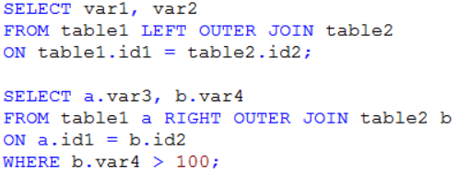
SQL – OUTER JOIN
Unlike inner joins which relate rows in both tables, outer joins also include rows with no related rows.
When using outer join syntax, you must use the RIGHT or LEFT keywords to specify the table from which to include all rows.

Slide 14
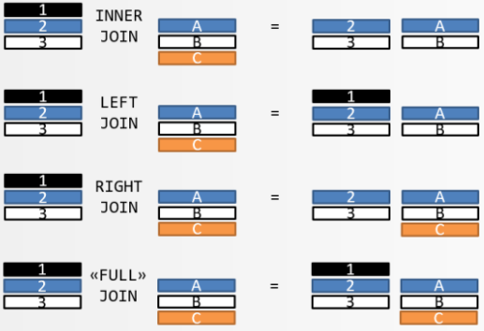
SQL –JOINS

Slide 15
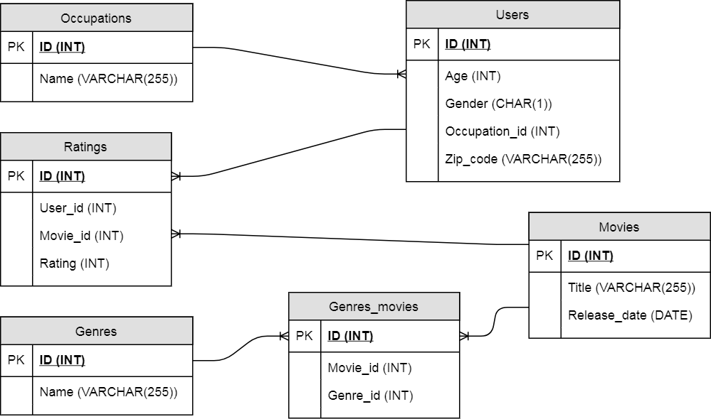
Entity Relationship Diagram

Slide 16
MySQL - Exercise
Login to Canvas and go to Module 3 – Exercise MySQL

Slide 17
Transactions
RDBMSs and SQL also support transactions.
A key feature of transactions is that they execute virtually at first, allowing the programmer to undo (using rollback) any changes that may have gone awry during execution; if all has gone well, the transaction can be reliably committed.
A transaction is “a transformation of state” that has the ACID properties

Slide 18
ACID properties
ACID is an acronym for Atomic, Consistent, Isolated, Durable, which are the gauges we can use to assess that a transaction has executed properly and that it was successful.
Atomic means “all or nothing”; that is, when a statement is executed, every update within the transaction must succeed in order to be called successful.
Consistent means that data moves from one correct state to another correct state, with no possibility that readers could view different values that don’t make sense together.
Isolated means that transactions executing concurrently will not become entangled with each other; they each execute in their own space. That is, if two different transactions attempt to modify the same data at the same time, then one of them will have to wait for the other to complete.
Durable: once a transaction has succeeded, the changes will not be lost. This doesn’t imply another transaction won’t later modify the same data; it just means that writers can be confident that the changes are available for the next transaction to work with as necessary.

Slide 19
Schema
A database schema
is the skeleton structure that represents the logical view of the entire database.
defines how the data is organized and how the relations among them are associated.
formulates all the constraints that are to be applied on the data.
defines its entities and the relationship among them.
contains a descriptive detail of the database.

Slide 20
Issues with Relational Databases
Although there are countless strategies and implementations for database storage and retrieval, most solutions are not built with very large scale and distribution in mind.
Many vendors (e.g. Oracle, IBM, etc.) offer replication and partitioning solutions to grow the database beyond the confines of a single node.
These add-ons are generally an afterthought and are complicated to install and maintain.
They also severely compromise the RDBMS feature set. Joins, complex queries, triggers, views, and foreign-key constraints become prohibitively expensive to run on a scaled RDBMS, or do not work at all.

Slide 21
Bigtable: Genesis of NoSQL
In 2006, Google released a whitepaper that would outline a new paradigm for databases and data storage:
“Bigtable: A Distributed Storage System for Structured Data.”
Bigtable was the distributed storage system for managing structured data at Google.
However, unlike existing RDBMS platforms, Bigtable was designed to reliably scale to petabytes of data and thousands of machines to meet Google’s application workload demand.
Bigtable paved the way for several Apache projects, including HBase, Cassandra, MongoDB and others.
NoSQL, which stands for Not Only SQL, is an integral product of the big data movement, and the Google Bigtable paper was a major catalyst for the movement.

Slide 22
Characteristics of NoSQL systems
NoSQL DB are schemaless at design time and “schema-on-read” at runtime - This means they do not have predefined columns, but columns are created with each PUT (INSERT) operation, and each record, document, or data instance can have a different schema from the previous instance.
Data has no predefined relationship to any other object - This means there is no concept of foreign keys or referential integrity, declarative or otherwise. Relationships may exist between data objects or instances, but they are discovered or leveraged at runtime rather than prescribed at design time.
Joins are typically avoided - In most NoSQL implementations, joins are kept to an absolute minimum, if not avoided altogether. This is typically accomplished by denormalizing data, often with a trade-off of storing duplicate data.

Slide 23
Characteristics of NoSQL systems
NoSQL systems are typically distributed (like Apache Cassandra or HBase) and are designed for fast lookups.
Write operations are typically faster as well, as many of the overheads of traditional relational database systems are not used, like datatype or domain checks, atomic/blocking transactions, or management of transaction isolation levels.
NoSQL systems, in the majority of cases, are built for scale and scalability from petabytes of storage to queries bounded in terabytes, performance, and low friction (having the ability to adapt to changes).

Slide 24
Types of NoSQL systems
NoSQL systems come in several variants or categories:
Key value stores contain a set or sets of indexed keys and associated values. Values are typically uninterpreted byte arrays, but can represent complex objects such as nested maps, structs, or lists. The schema is not defined at design time. Examples of key value stores include Redis and Memcached.
Column stores or wide-column stores, which store data tables as columns rather than rows and have an ability to hold very large numbers of dynamic columns. Examples of Column stores include HBase, BigTable.

Slide 25
Types of NoSQL systems, cont.
Document stores or document databases store documents, complex objects, such as JSON or BSON objects, or other complex, nested objects. The documents are assigned a key or document ID, and the contents would be the semi-structured document data. Examples of document stores include MongoDB and CouchDB.
Graph stores represent data in graph structures as nodes and edges, which are relationships between nodes. Examples of graph stores include Neo4J and GraphBase.

Slide 26
NoSQL databases and CAP theorem
The CAP theorem is sometimes called Brewer’s theorem after its author, Eric Brewer.
The theorem states that within a large-scale distributed data system, there are three requirements that have a relationship of sliding dependency:
Consistency: All database clients will read the same value for the same query, even given concurrent updates.
Availability: All database clients will always be able to read and write data.
Partition tolerance: The database can be split into multiple machines; it can continue functioning in the face of network segmentation breaks.

Slide 27
NoSQL databases and CAP theorem
Brewer’s theorem is that in any given system, you can strongly support only two of the three.
We have to choose between them because of this sliding mutual dependency.
In distributed systems, it is very likely that you will have network partitioning, and that at some point, machines will fail and cause others to become unreachable.
Distributed systems need Partition Tolerance!
For NoSQL databases, it leaves with only two real options to compromise on: availability and consistency.

Slide 28
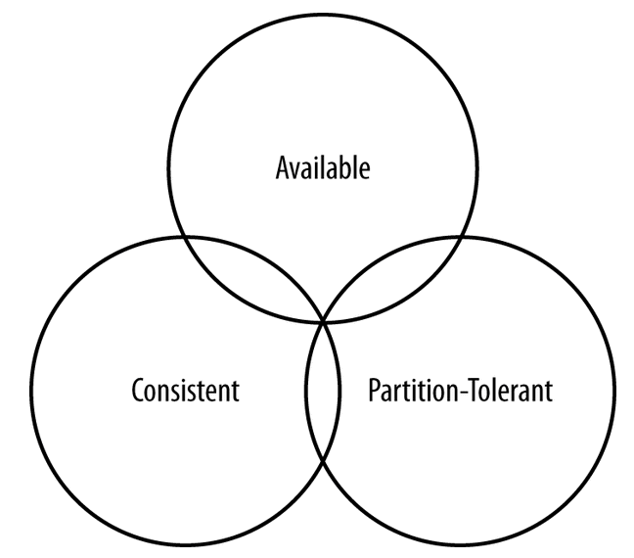
CAP theorem

Slide 29
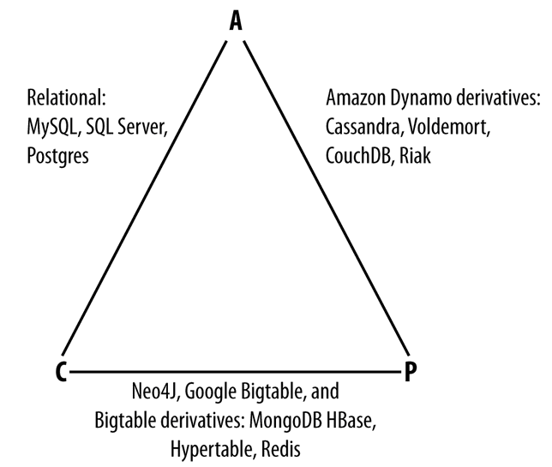
CAP theorem
Notes:
Write on board

Slide 30
HBase
HBase is a distributed column-oriented database built on top of HDFS.
HBase is the Hadoop application (amongst other) to use when we require real-time read/write random access to very large datasets.
HBase is able to do what an RDBMS cannot: host very large, sparsely populated tables on clusters made from commodity hardware.
HBase is not relational and does not support SQL, but it has an API to perform CRUD operations (Create, Read, Update, Delete).
HBase project was started toward the end of 2006 and was modeled after Google’s Bigtable paper, which had just been published.
The first HBase release was bundled as part of Hadoop 0.15.0 in October 2007. In May 2010, HBase graduated from a Hadoop subproject to become an Apache Top Level Project.
Today, HBase is a mature technology used in production across a wide range of industries.

Slide 31
HBase Data Model
HBase stores data as a sparse, multidimensional, sorted map.
The map is indexed by its key (the row key), and values are stored in cells (consisting of a column key and column value).
The row key and column keys are strings and the column value is an uninterpreted byte array (which could represent any primitive or complex datatype).
HBase is multidimensional, as each cell is versioned with a time stamp.

Slide 32
HBase Data Model
Row columns are grouped into column families.
At table design time, one or more column families is defined.
Column families will be used as physical storage groups for columns.
Different column families may have different physical storage characteristics such as block size, compression settings, or the number of cell versions to retain.
A table’s column families must be specified up front as part of the table schema definition, but new column family members can be added on demand.
Physically, all column family members are stored together on the filesystem.
We can say HBase is a column-family-oriented store.

Slide 33
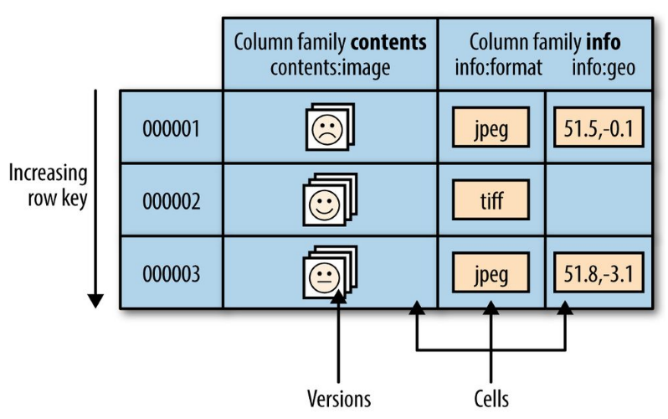
HBase Data Model
info:format and info:geo are both members of the info column family
contents:image belongs to the contents family.
A new column info:camera can be offered by a client as part of an update,

Slide 34
Regions
Tables are automatically partitioned horizontally by HBase into regions.
Each region comprises a subset of a table’s rows, usually a range of sorted row keys.
Initially, a table comprises a single region, but as the region grows it eventually crosses a configurable size threshold, at which point it splits at a row boundary into two new regions of approximately equal size.
Until this first split happens, all loading will be against the single server hosting the original region.
Regions are the units that get distributed over an HBase cluster.

Slide 35
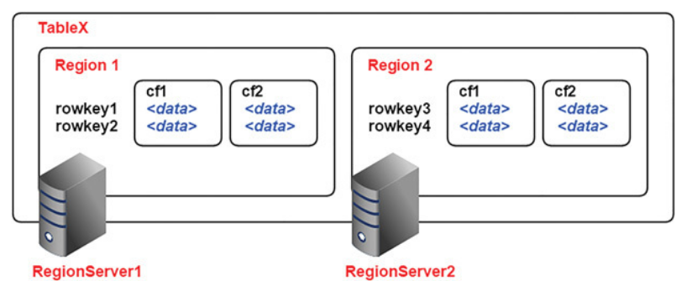
Regions

Slide 36
Implementation
Like HDFS is built of clients, workers, and a coordinating master, the namenode and datanodes, HBase is made up of an HBase master node orchestrating a cluster of one or more regionserver workers.
The HBase master is responsible for assigning regions to registered regionservers, and for recovering regionserver failures.
The regionservers manage region splits, informing the HBase master about the new daughter regions so it can manage the offlining of parent regions and assignment

Slide 37
HBase - Exercise
Login to Canvas and go to Module 3 – Exercise HBase

Slide 38

Cassandra
Another notable project emanating from the Bigtable paper is Apache Cassandra.
Cassandra was initially developed at Facebook and later released as an open source project under the Apache software licensing scheme in 2008.
Cassandra became a top-level Apache project in 2010.
Apache Cassandra is an open source, distributed, decentralized, elastically scalable, highly available, fault-tolerant, tuneably consistent, row-oriented database that bases its distribution design on Amazon’s Dynamo and its data model on Google’s Bigtable. Created at Facebook, it is now used at some of the most popular sites on the Web.

Slide 39
Distributed and Decentralized
Cassandra is distributed, which means that it is capable of running on multiple machines while appearing to users as a unified whole.
Cassandra is decentralized, meaning that every node is identical; no Cassandra node performs certain organizing operations distinct from any other node.
The fact that Cassandra is decentralized means that there is no single point of failure.
All of the nodes in a Cassandra cluster function exactly the same as opposed to the master/slave relationship in HBase for example.

Slide 40
Tuneable Consistency
Consistency essentially means that a read always returns the most recently written value.
Cassandra trades some consistency in order to achieve total availability.
Cassandra is frequently called “eventually consistent”, which is a bit misleading.
Eventual consistency means on the surface that all updates will propagate throughout all of the replicas in a distributed system, but that this may take some time. Eventually, all replicas will be consistent.
Cassandra is more accurately termed “tuneably consistent”, which means it allows you to easily decide the level of consistency you require, in balance with the level of availability.

Slide 41
Row-Oriented
Cassandra’s data model can be described as a partitioned row store, in which data is stored in sparse multidimensional hashtables.
Cassandra has frequently been referred to as a “column-oriented” database.
But Cassandra’s data store is not organized primarily around columns.
“Sparse” means that for any given row we can have one or more columns, but each row doesn’t need to have all the same columns as other rows like it.
“Partitioned” means that each row has a unique key which makes its data accessible, and the keys are used to distribute the rows across multiple data stores.

Slide 42
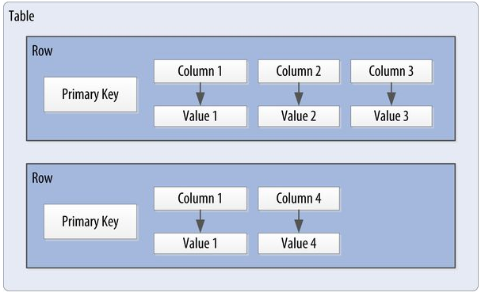
Cassandra Data Model
Cassandra uses a unique identifier/primary key for each row.
Rows can be seen as a group of columns that should be treated together as a set.
We don’t need to store a value for every column every time we store a new entity.
We have a sparse, multidimensional array structure

Slide 43
Gossip protocol
To support decentralization and partition tolerance, Cassandra uses a gossip protocol that allows each node to keep track of state information about the other nodes in the cluster.
The gossiper runs every second on a timer.
Gossip protocols
generally assume a faulty network.
are commonly employed in very large, decentralized network systems.
are often used as an automatic mechanism for replication in distributed databases.

Slide 44
Rings and Tokens
Cassandra represents the data managed by a cluster as a ring.
Each node in the ring is assigned one or more ranges of data described by a token, which determines its position in the ring.
A token is a 64-bit integer ID used to identify each partition.
Data is assigned to nodes by using a hash function to calculate a token for the partition/primary key.
The partition key token is compared to the token values for the various nodes to identify the range, and therefore the node, that owns the data.

Slide 45
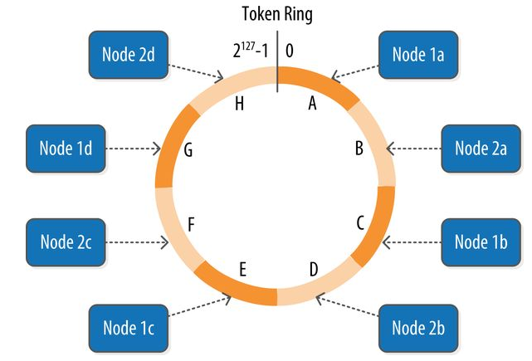
Rings and Tokens

Slide 46
MongoDB
MongoDB is a document-oriented database,
A document-oriented database replaces the concept of a “row” with a more flexible model, the “document.”
By allowing embedded documents and arrays, the document-oriented approach makes it possible to represent complex hierarchical relationships with a single record.
There are also no predefined schemas: a document’s keys and values are not of fixed types or sizes.
MongoDB’s document-oriented data model makes it easier for it to split up data across multiple servers (scaling out).
MongoDB automatically takes care of balancing data and load across a cluster, redistributing documents automatically and routing user requests to the correct machines.
Some features common to relational databases are not present in MongoDB, notably joins and complex multirow transactions.

Slide 47
MongoDB – Basic concepts
A document is the basic unit of data for MongoDB and is roughly equivalent to a row in a relational database management system.
A collection can be thought of as a table with a dynamic schema.
This means that the documents within a single collection can have any number of different “shapes.”
A single instance of MongoDB can host multiple independent databases, each of which can have its own collections.
Every document has a special key, "_id", that is unique within a collection.
MongoDB comes with a simple but powerful JavaScript shell, which is useful for the administration of MongoDB instances and data manipulation.

Slide 48
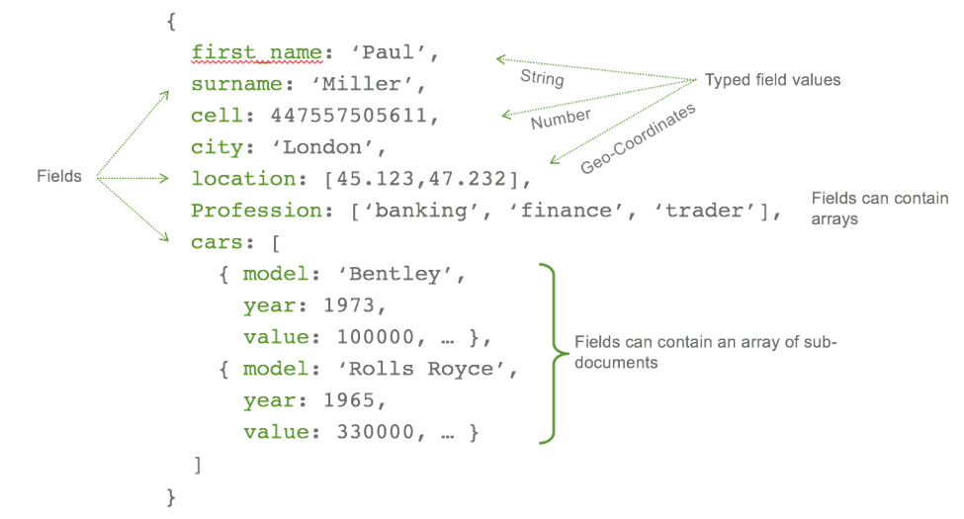
MongoDB
Documents are an ordered set of keys with associated values.
Most documents will contain multiple key/ value pairs.
The keys in a document are strings.

Slide 49
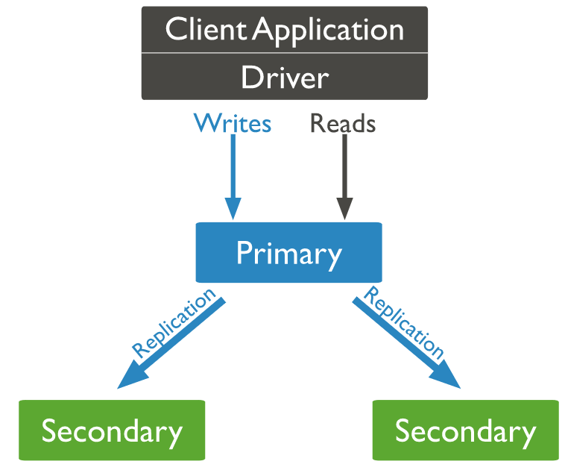
Replica Sets
Replication is a way of keeping identical copies of your data on multiple servers.
With MongoDB, you set up replication by creating a replica set.
A replica set is a group of servers with one primary, the server taking client requests, and multiple secondaries, servers that keep copies of the primary’s data.
If the primary crashes, the secondaries can elect a new primary from amongst themselves.

Slide 50
Replica Set Quirks
A majority of the servers in your set must agree on the primary.
Even numbers of servers (like 2) don’t work well.
If you have only 2 servers, you can set an arbiter, whose only purpose is to participate in elections.
Arbiters hold no data and aren’t used by clients: they just provide a majority for two-member sets.
Replicas only address durability, not your ability to scale
You can take advantage of reading from secondaries but this is generally not recommended
The database will still go into read-only mode for a bit while a new primary is elected (remember Availability in the CAP theorem).

Slide 51
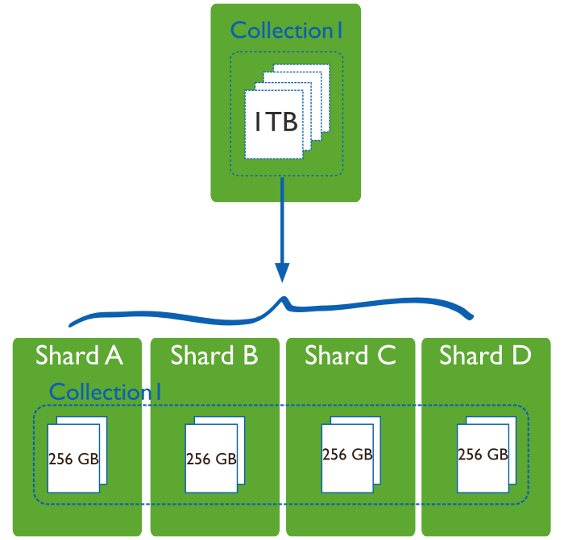
Sharding
Sharding refers to the process of splitting data up across machines; the term partitioning is also sometimes used to describe this concept.
MongoDB supports autosharding, which tries to both abstract the architecture away from the application and simplify the administration of such a system.

Slide 52
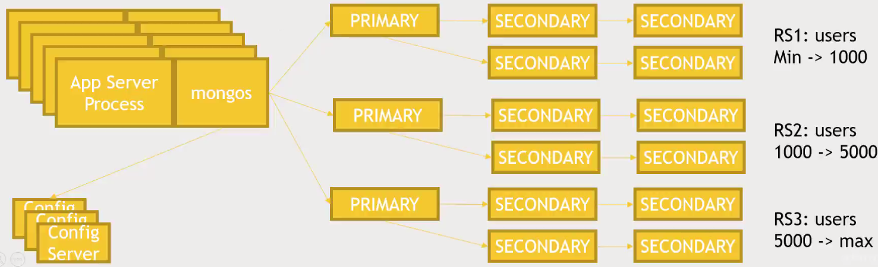
Sharding in MongoDB
Ranges of some indexed value you specify are assigned to different replica sets.
Notes:
Shards store the data. Each shard is a replica set.
Query Routers, or mongos instances, interface with client applications and direct operations to the appropriate shard or shards.
Config servers store the cluster’s metadata. This data contains a mapping of the cluster’s data set to the shards.

Slide 53
Sharding Quirks
Auto-sharding sometimes doesn’t work (in some very particular cases).
You must have 3 config servers.
If any one goes down, the entire DB is down.
This is on top of the single-master design of replica sets.
MongoDB’s loose document model can be at odds with effective sharding.
You still think about an effective Primary Key when dealing with sharding.

Slide 54
Group Discussion – Case 1
Form groups and discuss the following case:
Your employer wants to build a phone directory application.
The scale of this application should be less than 50,000 records.
The application can have eventual consistency (updated records can take 1-2 seconds to be available).
Availability is not critical but important (the application can be down for 2-3 hours, e.g. during week-end for maintenance).
We want to keep the administration simple.

Slide 55
Group Discussion – Case 2
Form groups and discuss the following case:
You want to mine web server logs (log files) for interesting patterns.
You want to answer some analytical questions such as:
What are the most popular times of the day?
What’s the average session length?
Somebody in your team is comfortable enough in Java to write MapReduce jobs.

Slide 56
Group Discussion – Case 3
Form groups and discuss the following case:
You have a big MapReduce job that produces movie recommendations for end users nightly.
Something needs to vend this data to your web applications.
You work for some huge company with massive scale.
Downtime is not tolerated.
Must be fast.
Eventual consistency is OK. You just read data.

Slide 57
Group Discussion – Case 4
Form groups and discuss the following case:
You are building a massive stock trading system.
Consistency is more important than anything.
“Big Data” is present.
Downtime can be tolerated for few minutes.
The stock trading data have various size and types.

Slide 58
References
White, Tom. Hadoop: The Definitive Guide: Storage and Analysis at Internet Scale, O'Reilly Media.
Aven, Jeffrey. Hadoop in 24 Hours, Sams Teach Yourself, Pearson Education.
Carpenter, Jeff; Hewitt, Eben. Cassandra: The Definitive Guide: Distributed Data at Web Scale, O'Reilly Media.
Chodorow, Kristina. MongoDB: The Definitive Guide: Powerful and Scalable Data Storage, O'Reilly Media
Forta, Ben. SQL in 10 Minutes, Sams Teach Yourself, Pearson Education.
Sundog Education by Frank Kane, The Ultimate Hands-On Hadoop - Tame your Big Data!
https://db-engines.com/en/
https://mindmajix.com/hadoop/difference-between-hbase-rdbms
https://pandaforme.gitbooks.io/introduction-to-cassandra/content/understand_the_cassandra_data_model.html

